Slide 1

Problem-Solving
For Supervisors
Notes:
Slide Show Notes
Today we’re going to talk about problem-solving. As you well know, problems are a fact of your daily working life. You can’t avoid them. The best you can do is recognize them and try to solve them before they cause more problems.
Learning to identify problems and develop effective solutions is one of the biggest challenges any supervisor faces. At the same time, the skill with which you deal with problems on the job has a direct impact on your effectiveness as a supervisor and on your career success.
The problem-solving methods you will learn in this session can help you identify and resolve work problems more quickly and effectively, and consequently, be more successful in your job.

Slide 2

Session Objectives
Understand the important role problem-solving plays in your job
Identify the basic steps in the problem-solving process
Apply a variety of effective techniques to solve workplace problems
Notes:
Slide Show Notes
The main objective of this session is to help you become a highly effective problem-solver. By the time the session is over, you should be able to:
Understand the important role problem-solving plays in your job;
Identify the basic steps in the problem-solving process; and
Apply a variety of effective techniques to solve workplace problems.

Slide 3


Prequiz:
True or False?
Effective supervisors don’t experience workplace problems.
It’s not a good idea to involve employees in problem-solving.
You should solve problems in the order they arise.
Most problems are solved by trial and error.
Notes:
Slide Show Notes
Before we begin the session, let’s take just a few minutes to see how much you already know about problem-solving. Read each of the statements on the screen and decide if it is true or false.
1. Effective supervisors don’t experience workplace problems. This is
false—all supervisors will experience workplace problems from time
to time.
2. It’s not a good idea to involve employees in problem-solving. This is
false—employees should be involved in the problem-solving process.
3. You should solve problems in the order they arise. This is true.
4. Most problems are solved by trial and error. This is true.
[PAUSE] How did you do? If you got all the answers right, you already know quite a bit about workplace problem-solving. During this session, you have the opportunity to learn a lot more.

Slide 4

Got Problems?
Problem—n. an obstacle to achieving goals;
a question raised for inquiry, consideration,
or solution.
Notes:
Slide Show Notes
If you’ve got problems, you’re not alone. For most supervisors, it’s rare that a day goes by without problems. But, of course, that goes with the territory. Trouble-shooting and problem-solving are two very important functions of your job. What is a problem? It’s defined as an obstacle to achieving goals or a question raised for inquiry, consideration, or solution.
You probably handle a variety of problems as well. For example, you may have to find ways to eliminate barriers to successful employee performance, handle conflicts between employees or between your department and others, deal with problems concerning necessary resources, manage equipment problems, or handle scheduling problems. The list could probably go on and on.
But that’s OK because successful supervisors become skilled problem-solvers. What’s more, they learn to take a proactive approach to problem-solving. They become good at spotting problems early and dealing with them head-on before they get any bigger.
Take a few moments to think of all the problems you’ve dealt with over the past month. You’ll probably think of quite a few items and quite a variety of problems as well.
Have trainees write a list of all the problems they’ve dealt with over the past month. Then have them read and comment on their lists.

Slide 5

Find a Solution!
“
The biggest problem
in the world could
have been solved
when it was small.
—Lao Tzu
The Way of Life
”
Notes:
Slide Show Notes
It isn’t actually having problems that’s the problem. It’s finding solutions. The important thing to remember is that there’s always a solution to every problem. You just have to find it. And you have to find it early on when a problem is still small. You never want to wait until a little problem becomes a big problem, or a big problem becomes a bigger one. Because then it’s just going to do that much more damage and be that much harder to solve.
Remember those problems you thought about in the previous slide? Well, now think about how they turned out? Were your solutions effective? How did you arrive at your solutions?
Lead a discussion about how trainees are currently solving their problems on the job.

Slide 6


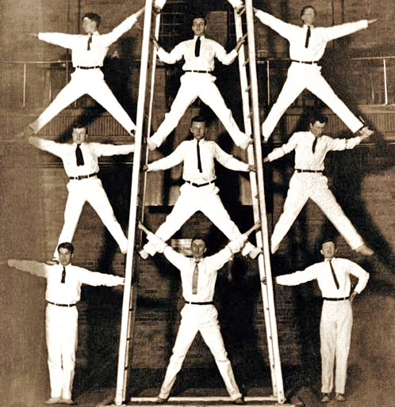

Get Help
  Ask
  Tap
  Build
  Delegate
Notes:
Slide Show Notes
Before you jump in and try to solve a workplace problem, however, it’s often a good idea to get some help. You don’t have to go it alone. Here are a few suggestions about where to look for help solving problems:
Ask your boss or other supervisors for their perspectives on the problem. Ask an in-house expert, such as an HR or safety specialist. Consult books and journals. Go online to reliable sources such as trade associations, educational and government websites, and suppliers’ websites—HR.BLR.com® or Safety.BLR.com®, for example.
Tap into the ingenuity of your employees. They have lots of knowledge about their jobs, and most of them would love to be asked their ideas and suggestions. What’s more, getting employees involved in problem-solving is a great way to challenge them, encourage participation, and motivate them to higher levels of performance.
Build on the ideas of others. Look at how others have solved similar problems. Then build on or modify those solutions to suit your problem.
Delegate problem-solving responsibilities to qualified employees or a team of employees who have the knowledge and experience to develop a good solution.

Slide 7
The Impact of Input
NEW IDEAS
SOLUTIONS
POSSIBILITIES
ASSOCIATIONS
Notes:
Slide Show Notes
The impact of input can be substantial.
Others can give you new ideas—things you might not have
thought of.
These ideas can lead you to consider a variety of possibilities.
The possibilities might spark associations to other ideas, allowing you to make connections to yet other possibilities.
And finally, input can lead you to a workable, successful solution to a problem.
Now let’s continue to the next series of slides and focus on six simple steps you can take to help you solve any problem.

Slide 8





Step 1: Identify the Problem
Observe
Define
Stick to facts
Ask questions
Summarize
Notes:
Slide Show Notes
The first step in problem-solving is to identify the problem. If you don’t pinpoint the problem, you could easily end up with a faulty solution.
Begin by observing. What’s actually happening? How often does it happen? When and where does it happen? What are the consequences? Watch and learn.
When you’ve seen enough, define the scope of the problem. How widespread is it? How serious is it? Who’s affected?
At this point, stick to the facts. Only state what you know to be true, not what you think might be happening.
Ask more questions that can help you define the problem and determine the facts. The more questions you ask, the more answers you’ll find, and the more answers you have, the sooner you can develop an effective solution to the problem.

Slide 9

Step 2: Prioritize
Unusual
Minor
Can’t live with consequences
Routine
Urgent
Can live with consequences
Significant
Not urgent
TOP
PRIORITY
2ND
PRIORITY
Notes:
Slide Show Notes
Step Two is to prioritize. You probably won’t be able to deal with all the problems that come your way every day all at the same time. Some will be more important than others and require a higher priority. Prioritizing problems is really a simple sorting process.
Begin prioritizing by determining the significance of the problem. If it’s big and important, it needs attention soon. Make it a top priority. Minor problems are second or even third priority. They can go on your To Do list to be handled when you have the time. Or they can be delegated.
Is the problem urgent or can it wait? If it’s urgent, it’s top priority. If it isn’t, it can be handled later when you have more time.
Is the problem unusual or routine? Unusual problems usually require immediate attention because you may not know the scope or the consequences. You might want to assign a team to help explore the problem and look for a solution. Routine problems can usually be given second priority. Since you probably already know the solution, these problems can easily be delegated.
Finally, another way to prioritize is to ask if you can live with the consequences of the problem for a while or if you can’t. If you can’t, it’s a top priority problem, and you have to get on it right away.

Slide 10

Step 3: Gather Information
What you need to know:
  Details
  Advice
  Causes
  Extent
  Multiple or
  related problems
What you need to know:
  Details
  Advice
  Causes
  Extent
  Multiple or
  related problems
Notes:
Slide Show Notes
Once you’ve identified a problem and given it a priority, it’s time to gather information, beginning with your top priority problems, of course.
Make sure to examine all the details and find out everything possible about every problem. Insufficient information often leads to inadequate solutions.
Get advice from colleagues, experts, and others familiar with the problem or ones like it. The more input, the more you’ll know about the problem.
Look for potential causes. There are one or more causes behind every problem. You need to find causes to understand the problem fully.
Determine the extent of the problem. You may already know this from the information you learned by observing in Step One. If not, find out.
Also check for multiple or related problems. Sometimes there’s more than one problem at work. Or maybe there are related problems that also need to be solved. If you don’t solve all the problems, you still have a problem.
Think of the various ways you gather information about problems and the resources you tap to learn what you need to know.
Ask trainees to talk about how they gather information about problems.

Slide 11

Step 4: Generate
Possible Solutions
Brainstorming—
n. a group problem-solving technique that involves the spontaneous contribution of ideas from all members
of the group
Notes:
Slide Show Notes
Step Four in the problem-solving process is to generate possible solutions. There are lots of ways to do this. You can ask “What if?” questions, for example, and follow those answers where they lead.
You can draw on previous experience with similar problems. It’s always a good idea to think back to prior problems and solutions for inspiration.
You can also get together with a group of employees and brainstorm. Brainstorming is a group problem-solving technique that involves the spontaneous contribution of ideas from all members of the group. This is one of the best ways to solve problems, and it’s also a great way to challenge employees and get them to participate more. When you brainstorm, don’t put any limits on creativity. Let the group come up with as many solutions as possible. No idea is out of bounds. Guide the group to build on one another’s ideas as well.
Remember, at this stage, you want to explore all possible options. Be open-minded and don’t exclude any possibilities, even if they seem unrealistic or unusual. You never know where such ideas might lead.
Do you use some of these strategies to generate possible solutions to problems? What other strategies do you use?
Lead a discussion about strategies for generating possible solutions to workplace problems.
2/02-Animated

Slide 12

Step 5: Select an Option
CALCULATE
CHOOSE
TEST
MONITOR
IMPLEMENT
PRESENT
Congratulations! You’ve got a
DOCUMENT
Notes:
Slide Show Notes
Now let’s move on to Step Five, selecting a solution from among all the options you’ve generated in the previous step.
To do this, you have to first calculate the consequences of each of the possible choices available to you. Ask yourself what the situation would look like if you implemented each potential solution. You might not always like what you see. Now’s the time to find out.
Next, make a list of your top five possible solutions and pick the best one.
Then test your solution on a small scale if possible just to make sure it works like you think it will.
Now you’re ready to present the solution to all those who are affected by the problem and will be involved in implementing and evaluating the solution.
Then, it’s time to implement your solution.
Monitor carefully after implementing to make sure everything’s going as anticipated.
And finally, be sure to document the details of the problem and the solution. This can help you retrace your steps should the problem recur.
Once you’ve done all that, congratulations! You’ve got a solution!

Slide 13

Step 6: Follow Up and Encourage Feedback
  Listen
  Verify
  Evaluate
  Assess
Notes:
Slide Show Notes
The final step is one many supervisors forget, but it may be the most important one of all—follow up and encourage feedback. This means you have to:
Verify that the problem really has been resolved;
Assess the long-term effectiveness of your solution;
Anticipate future problems along the same lines;
Listen to feedback from stakeholders in the problem-solving process; and
Evaluate the need for adjustment. Some solutions might need a little tweaking to make them just right.
Do you always remember to follow up and encourage feedback about solutions to problems? This is a very important step. It ensures an effective solution and one less problem you have to worry about.
Emphasize the importance of this final step in the problem-solving process. Point out that failure to follow up and hear feedback from those who know how well the solution is working can lead to bigger problems down the line.

Slide 14

Problem-Solving Process
Do you understand:
  Importance of problem-solving?
  Where to look for help?
  Steps in the problem-solving process?
Notes:
Slide Show Notes
Now it’s time to ask yourself if you understand the information presented so far. Do you understand what we’ve discussed about:
The importance of problem-solving in your job?
Where to look for help solving workplace problems?
The steps in the problem-solving process?
It’s important for you to understand all this information so that you can find the most effective solutions to the problems you and your employees face every day on the job.
Answer any questions trainees have about the information presented in the previous slides.
Conduct an exercise, if appropriate.
Let’s continue to the next slide now and put your brain to work trying to solve a little problem.

Slide 15

Can You Solve This Problem?
Connect the dots using
four continuous lines
Notes:
Slide Show Notes
OK, here’s the problem. It may not be much like any workplace problem you’ll have to solve, but this little exercise will help stretch your thinking to consider a lot of possibilities as solutions. Think back to Step Four. When you’re faced with a problem like this one, you may have to generate a lot of ideas before you hit on the right solution. You might also have to think outside the box.
The problem here is to use your mouse to draw lines connecting all the dots on the screen. The trick is that you can only use four straight lines and the lines have to be continuous. You can’t retrace any line or “lift your pencil,” so to speak.
Are you ready for the answer? Here it is.

Slide 16
How About This Problem?
Connect the dots using
only three continuous lines
Notes:
Slide Show Notes
Let’s try solving the same problem again, only we’ll make it a little tougher this time. You can only use three continuous lines now.
OK here is the answer.
How did you do? Did you get the right solution to this problem? Now let’s move on. In the next series of slides we’re going to focus on a variety of problem-solving techniques, some of which you might be able to use to help you solve problems on the job.

Slide 17

Ask Why 5 Times
Question #1 Answer #1
Question #2 Answer #2
Question #3 Answer #3
Question #4 Answer #4
Question #5 Answer #5
Notes:
Slide Show Notes
The first technique we’re going to talk about comes from the Japanese, who have used this deceptively simple but remarkably effective technique to solve many tough production and quality problems. Here’s how it works: Whenever you’re faced with a workplace problem, you must ask why.
Question number one is: Why are we having this problem? The answer becomes your next question, and you go on like this, asking and answering questions, until you’ve asked why five times. Here’s an example: Some delicate components used to assemble products are turning up broken.
First question: Why are the components broken? First answer: Because the carton they came in was damaged.
That leads to the second question: Why was the carton damaged? Second answer: Because a worker stacked or transported the cartons improperly.
Third question: Why did the worker handle the cartons improperly? Third answer: Because the worker did not know the proper method.
That answer leads to question four: Why did the worker lack the necessary information? And the fourth answer: Because the worker was improperly trained or failed to pay attention to training.
And finally, the fifth question: Why did training fail? And the fifth answer: Well … that answer is the ultimate solution to the problem, isn’t it?

Slide 18



Problem Reversal
  Flip the question
  Opposite thinking
  Start with a solution
Notes:
Slide Show Notes
Here’s another simple technique. It’s called problem reversal. Sometimes just turning a problem on its head can help you solve it.
For example, you can flip the question. Say your problem is low productivity. Normally, you’d ask, How can we increase productivity? But with problem reversal you ask, How could we decrease productivity still further? By flipping the question, you get a different perspective, which gives you the opportunity to come up with different solutions.
Opposite thinking is another approach. If a solution you’ve been pursuing isn’t working, try the opposite. Even if that doesn’t work, you open up new possibilities. For example, say that when you get home at night you drop your car keys outside in the dark and can’t find them. Conventional wisdom would tell you to wait and look for them in the morning. But opposite thinking says look for them now in the dark. Why? Because keys are shiny, and if you use a flashlight, they’ll be easy to spot when caught in a beam of light.
The third reversal technique is to start with a solution instead of trying to identify the cause of the problem. Imagine the problem is solved. How would that look? How would it work? This kind of thinking can sometimes lead you back through the problem to the root cause.

Slide 19
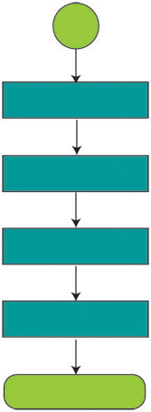

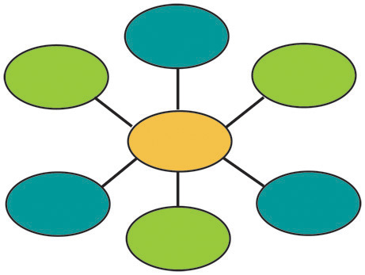
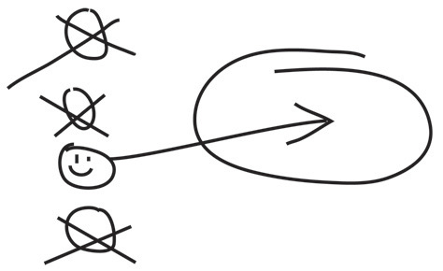
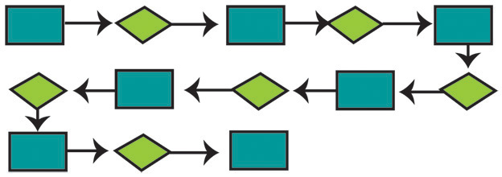
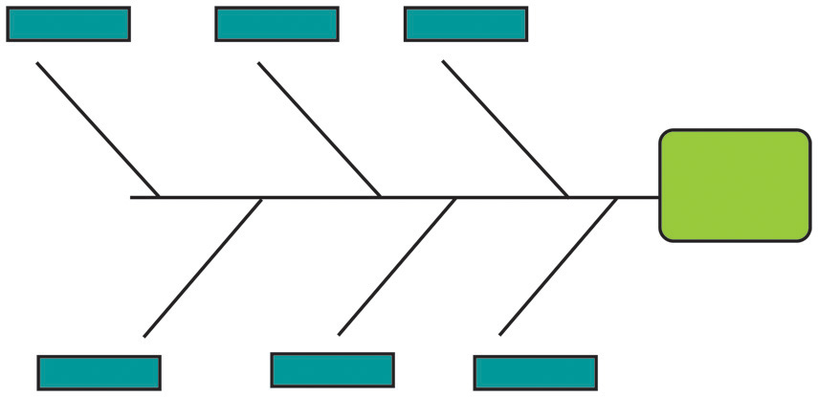
Visual Approaches
Notes:
Slide Show Notes
Using visual approaches to problem solving can also be very helpful.
The simplest method is to draw a picture of the problem—a doodle, a diagram, a map. This might help you see where the problem lies.
Another approach is called a fishbone diagram. Draw a horizontal line. This is the fish’s spine, or the problem. Draw vertical lines off that line. Each of these “bones” is a possible cause of the problem.
Then there are flowcharts. They help you see problems such as bottlenecks in processes or gaps in procedures. All you have to do is draw labeled boxes to represent activities in the order they’re performed and connect the boxes with arrows to show the flow of activity.
Spider diagrams look like they sound. They can help you see issues related to problems and the consequences of problems. Just draw a circle in the middle of your paper and label it as the problem. Lines drawn out from the center, like legs of a spider, represent related issues and/or consequences.
Frequency charts help you visualize when and how often a problem occurs.
And relationship diagrams help you determine how the various elements of a problem are connected. Write them all down on paper and draw lines between them to show relationships.

Slide 20






More Helpful Techniques
Analogy
Reframe
Break down
Simplest solution
Sleep on it
Take a walk
Notes:
Slide Show Notes
Here are some more helpful techniques.
Analogies help you make connections to other parts of your life. For example, when dealing with a conflict between two employees, you might apply personal experience with conflicts at home to help you solve the problem.
Reframing a problem helps you see a different perspective. For example, if an employee is failing to meet performance goals, you might reframe the question, “Why doesn’t the worker meet goals?” to “Why can’t the worker meet goals?” Now it’s a different picture. Maybe it isn’t about motivation, but about barriers or lack of skills.
Breaking a problem down into smaller parts is always helpful.
And so is looking for the simplest solution. It might be right in front of your nose. During World War II, experts were stumped about how to sharpen the carbon electrodes on searchlights. A private who knew nothing about searchlights suggested a pencil sharpener. It worked!
Sleeping on a problem or putting it on the back burner is amazingly effective sometimes. Your mind will keep working away at the problem and next day you may be able to see something new.
Taking a walk to clear your mind can also help. There’s something about the rhythm of walking that refreshes you and helps you see more clearly.

Slide 21

Roadblocks to Successful Problem-Solving
FEAR OF MISTAKES
RUSHING
ASSUMPTIONS
Notes:
Slide Show Notes
In addition to being knowledgeable about problem-solving techniques, you should also be aware of roadblocks to successful problem-solving.
The first roadblock is making assumptions. Just because something has always worked a certain way doesn’t mean that’s what’s happening this time. You might have heard the story of the guy who comes home late one night and has forgotten his keys. He doesn’t want to wake his family so he uses a ladder to climb up to an open bathroom window on the second floor. He’s struggling to get through the small window when his foot kicks the ladder and it falls. Now he’s stuck half in and half out of the window and can’t move. He shouts for his wife and ends up waking the whole family and half the neighborhood. After they finally get him in, his wife asks, “Why didn’t you just come in the back door? I left it open because I know you always forget your keys.” Because the guy always locked the back door before going to bed, he assumed it would be locked. So it never occurred to him to try it.
Rushing can also be a barrier to effective problem-solving. Grabbing the first solution rather than taking the time to develop the best solution isn’t a great idea.
Nor is being so afraid of making a mistake that you reject any solution that might be wrong. Sometimes you have to risk making a mistake to find a good solution rather than a safe one.

Slide 22
Roadblocks to Successful
Problem-Solving (cont.)
BEING
TOO LOGICAL
LACK OF CONFIDENCE
GIVING UP
DENIAL
Notes:
Slide Show Notes
Another roadblock to successful problem-solving is being too logical. Logic is certainly important. But you also have to use your intuition and creativity to craft the best solutions to the toughest problems.
Denial is another barrier. People often fail to solve problems they’re perfectly capable of solving only because they bury their heads in the sand and pretend there’s no problem rather than facing it head on.
Lack of confidence as a problem-solver is another roadblock. If you think you can’t solve a problem, you probably won’t. On the other hand, if you approach problems with a positive, can-do attitude, you’re most likely to succeed.
And finally, there’s giving up. Especially when faced with a big problem, some people throw up their hands and quit. Whereas if they’d just hang in there and do what they can to solve the problem, they’ll eventually find a solution.
President Teddy Roosevelt, a guy who faced some mighty tough problems building the Panama Canal, once said, “Have you got a problem? Do what you can where you are with what you’ve got.”
Albert Einstein, one of the smartest people on the planet, said, “It’s not that I’m so smart; it’s just that I stay with problems longer.” So don’t give up. Stay with the problem. You’ll find a solution in the end.

Slide 23

Solving Recurring Problems
Use this template to solve recurring problems
What’s the real problem?
How often does it occur?
When does it occur?
How bad is it?
Notes:
Slide Show Notes
Sometimes you’re faced with recurring problems, problems that just won’t go away. What can you do then? Begin by asking and answering some important questions. For example:
What’s the real problem? Maybe you’ve been trying to solve the wrong problem. Or maybe the problem is really more complicated than you thought, and you’ve only been dealing with one aspect
of it.
How often does the problem occur? You can use a frequency chart to answer this question.
When does it occur? And under what circumstances does it occur? Also, when does it not occur? This information will give you a lead about why it’s occurring.
How bad is this recurring problem? How much damage does it cause each time it comes back?

Slide 24
Solving Recurring Problems
(cont.)
Where does it occur?
Who is involved
What information have you got?
What additional/alternative steps must you take?
Notes:
Slide Show Notes
To solve recurring problems, you also have to ask:
Where does this problem occur? Does it only happen in a particular place? Are there areas where it doesn’t occur?
Who is involved? Is it a particular employee or group of employees? If so, maybe additional training is needed to resolve the problem.
What information have you got from past occurrences? Do you see any patterns? What does your data tell you about causes?
What additional or alternative steps could you take to solve this problem permanently? Rethink your solution and your plan of action. Get a fresh perspective on the problem using the problem-solving process we described at the beginning of the session and some of the techniques we’ve discussed in previous slides.
Think about some recurring problems you’ve faced and how you handled them. Were you finally able to solve them permanently?
Lead a discussion about the types of recurring problems trainees have faced and the strategies they’ve used to find permanent solutions.

Slide 25




Review
Focus attention and observe
with an open mind
Identify the real problem
eXamine the details
Invent a solution
Test your solution
Notes:
Slide Show Notes
Now let’s take a couple of minutes for a quick review. One easy way to remember the essentials of problem-solving is to remember the word FIXIT, which stands for:
Focus your attention and observe with an open mind. What’s really going on and why? Take a long, hard look before you come to any conclusions.
Identify the real problem. Sometimes problems aren’t what they seem to be at first glance. Identify the problem incorrectly and your solution won’t be very effective.
EXamine the details. Break the problem down and look closely at the smallest details. This will tell you what you need to do to fix it completely and permanently.
Invent a solution. There is often more than one solution to a problem. You want the most effective and efficient one. Be creative. Think before you decide which to implement.
Test your solution to make sure it works, and follow up to make sure it keeps working.

Slide 26


Put the Pear in the Bottle
?
PROBLEM:
How would you get the pear in the bottle?
Notes:
Slide Show Notes
Here’s a little creative problem-solving exercise for you.
In France they make a pear brandy with a twist. Sitting in the bottom of the bottle is a full-grown pear. Now, there’s no way to get a pear that size through the narrow neck of the bottle. So how do they do it?
Think about it for 30 seconds, and then turn to the next slide for the solution.
[30-second pause. Buzzer sounds.] Time’s up. Go to the next slide.

Slide 27

Put the Pear in the Bottle (cont.)
SOLUTION:
Grow the pear in the bottle!
Notes:
Slide Show Notes
The solution is quite simple, but not ordinary.
They grow the pear in the bottle. They stick the tip of the branch of the pear tree into the bottle while the tiny budding pear is still small enough to fit through the neck of the bottle.
Did you figure it out? You might be able to apply the same kind of “out of the box” thinking to a production problem or some other workplace problem some day.

Slide 28

Problem-Solving Techniques
Do you understand:
  Problem-solving techniques?
  Roadblocks to successful problem-solving?
  How to solve recurring problems?
Notes:
Slide Show Notes
Let’s take a moment now to make sure you understand all the information presented in the previous slides. For example, do you understand:
The problem-solving techniques we’ve discussed?
Roadblocks to successful problem-solving?
How to solve recurring problems?
This information will help you solve a variety of workplace problems effectively and efficiently.
Answer any questions trainees have about the information presented in the previous slides.
Conduct an exercise, if appropriate.
Now let’s conclude the session with some key points to remember.

Slide 29

Key Points to Remember
Problem-solving is an important part
of your job.
Your problem-solving skills have an
impact on your career.
Take advantage of input from others.
You can solve any problem.
Notes:
Slide Show Notes
Here are the main points to remember from this session on problem-solving:
Problem-solving is an important part of your job.
The skill with which you solve problems has a direct impact on your effectiveness as a supervisor and your career success.
Be sure to take advantage of input from employees, colleagues, and others.
By taking a step-by-step approach and applying a variety of techniques, you can solve any problem.
This concludes the problem-solving training session.
Give trainees the quiz, if appropriate.

